Slide 1
Predictive Lead Scoring Final Project Group 22

Slide 2
Project analysis slide 2
Outline
Modeling
Concept and Idea
PROJECT
Evaluation
What is our Data?
Conclusion
Data Cleaning

Slide 3

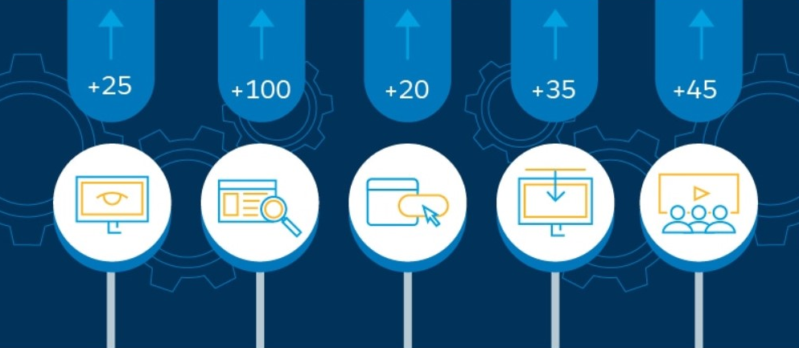
Project analysis slide 11
Predictive Lead Scoring
In marketing domain, Lead scoring is a methodology used to rank prospects against a scale in order to differentiate leads and prioritize them for sales
In conventional lead scoring, there are predefined set of rules that give each activity a positive or negative value known as score and based on these rules, each lead will have a total score
Machine learning techniques can be used to discover the possible patterns and shared behavior between leads that are more likely to become a customer

Slide 4

Project analysis slide 11
Our Goal
Use Machine Learning algorithms to extract valuable features in predicting the conversion of a lead to a customer and use these features for modeling
Higher accuracies result in more effective efforts in marketing departments

Slide 5
Project analysis slide 11
Data
We found appropriate data on Kaggle which is a great source for secondary data
Initially, this dataset had around 9000 rows and 37 columns
From these 37 columns, one of them is names “Converted” which is the target variable
Lead Number | How did you hear about X Education | Lead Quality
Lead Origin | What is your current occupation | Update me on Supply Chain Content
Lead Source | What matters most to you in choosing a course | Get updates on DM Content
Do Not Email | Search | Lead Profile
Do Not Call | Magazine | City
Converted | Newspaper Article | Asymmetrique Activity Index
TotalVisits | X Education Forums | Asymmetrique Profile Index
Total Time Spent on Website | Newspaper | Asymmetrique Activity Score
Page Views Per Visit | Digital Advertisement | Asymmetrique Profile Score
Last Activity | Through Recommendations | I agree to pay the amount through cheque
Country | Receive More Updates About Our Courses | A free copy of Mastering The Interview
Specialization | Tags | Last Notable Activity

Slide 6
Project analysis slide 4
Steps Throughout the
Project
Logistic Regression
Data Cleaning
Recursive Feature Selection
Classification Algorithms
SVM
Descriptive Analysis
Random Forests

Slide 7

Project analysis slide 11
Data Cleaning
Missing values and duplicates
Deleting Duplicate rows
Deleting Columns with too much null values
Correlation
Deleting Columns that had low correlation with target variable
Making all variables numerical
Outliers
Normalize
Replacing null values with the most common value
Creating dummy variables for categorical columns
Z-score<-3
Z-score>3
Deleting Columns with only one value
Training and Test sets

Slide 8
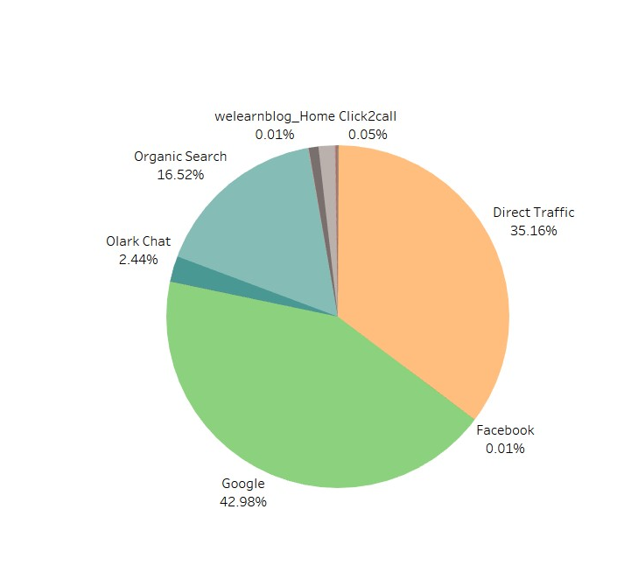
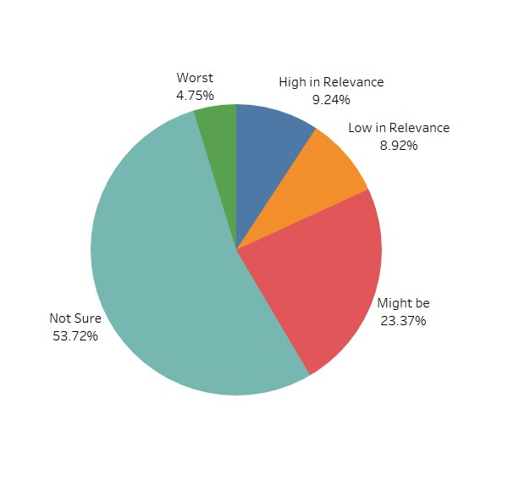
Project analysis slide 11
Visualization

Slide 9
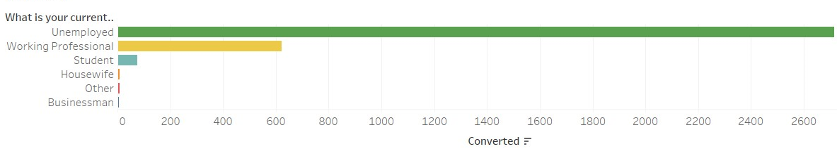
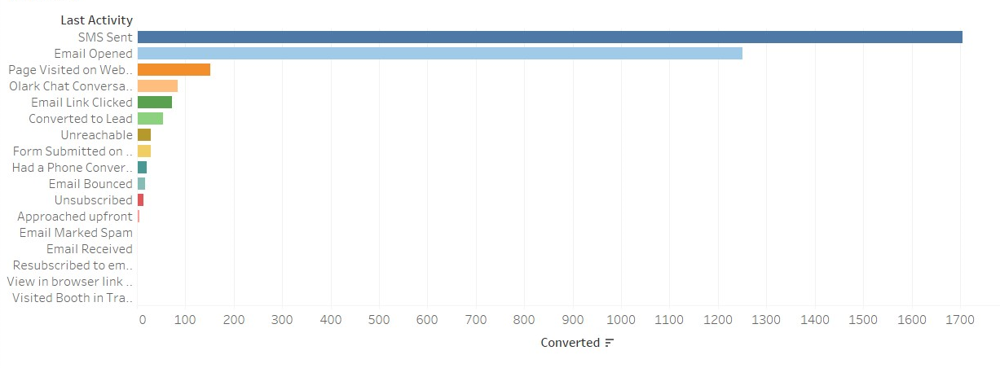
Project analysis slide 11
Visualization using Tableau

Slide 10
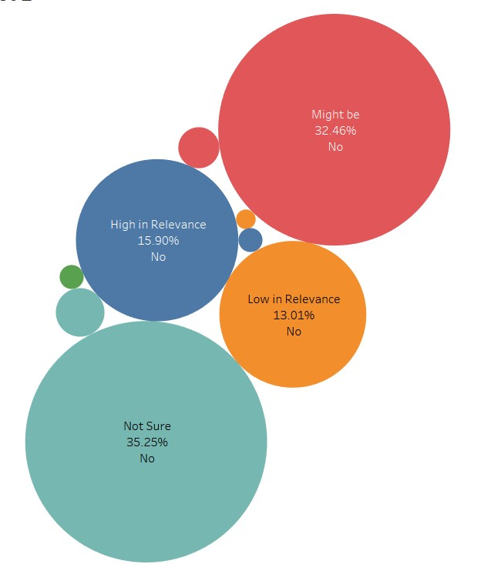
Project analysis slide 11
Visualization
Most probably, Emails are not an effective means of marketing for this business!

Slide 11
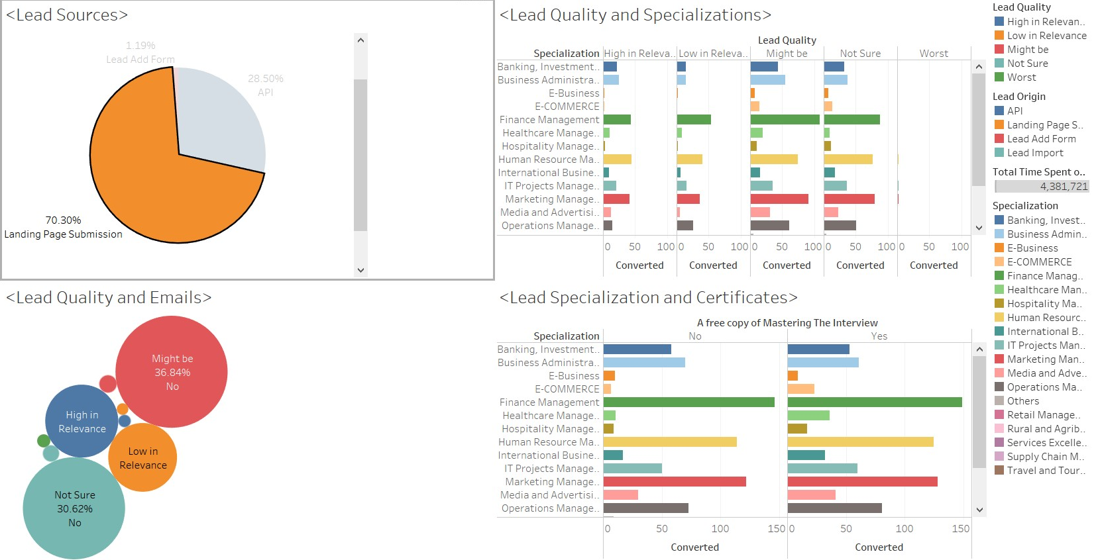
Project analysis slide 11
Dashboard for Managers

Slide 12

Project analysis slide 11
Classification
Our target variable is a binary variable
1 for leads that converted into customers
0 for leads that did not convert into customers
These values are labels that can be used for classification

Slide 13
Project analysis slide 11
Classification
Logistic Regression
In this model, we also did feature selection using RFE. RFE is a feature selection algorithm that recursively removes features, builds a model using the remaining attributes and calculates model accuracy. RFE can work out the combination of attributes that contribute to the prediction on the target variable
Random Forests
Random forests are a decision tree algorithm. They have some advantages over the basic decision tree algorithms such as being able to handle outliers and missing values, not assuming a specific underlying distribution about the data, and doing some sort of feature extraction of its own.
SVM
Support Vector Machines are also a classification algorithm that we decided to use in order to relate this project with class material
Notes:
Although we have cleaned the data and did feature selection, it can be a good idea to perform random forests on the data and see if it will further enhance the prediction accuracy.

Slide 14
Project analysis slide 11
Feature Selection
RFE or Recursive Feature Elimination is a feature selection algorithm.
It recursively removes features, builds a model using the remaining attributes and calculates model accuracy. RFE can work out the combination of attributes that contribute to the prediction on the target variable
We used RFE with Logistic Regression in order to get the most informative and valuable features for classification model
These subset of features not only result in higher accuracy, but also leads to higher speed in modeling and classification (in terms of run time)
All variables
109
RFE
12

Slide 15
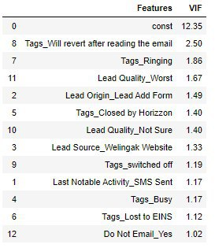
Project analysis slide 11
VIF
Variance Inflation Factor is an important factor while creating a regression model. assesses whether there is multicollinearity in the model or not. It is believed than if VIF is less than 10, it is acceptable.

Slide 16
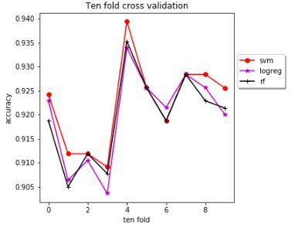
Project analysis slide 11
Evaluation
 | Training set accuracy | Test set accuracy
Logistic Regression without RFE | 0.9010883041 | 0.9002754820
Logistic Regression with RFE | 0.9199614227 | 0.9101928374
Random Forests | 0.9236809477 | 0.9157024793
SVM | 0.9229921476 | 0.9162534435
Logistic Regression | Random Forests | SVM
0.9223037902 | 0.9195483993 | 0.9198236914

Slide 17
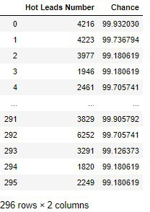
Project analysis slide 11
Conclusion
SVM model has slightly higher accuracy from Random Forests and performs as the best model
We could successfully identify leads within the test set who would become a customer with a probability of more than 90%

Slide 18
Thank You

